Slide 1

User Guide
Wilson Gan & Philip Kim

Slide 2
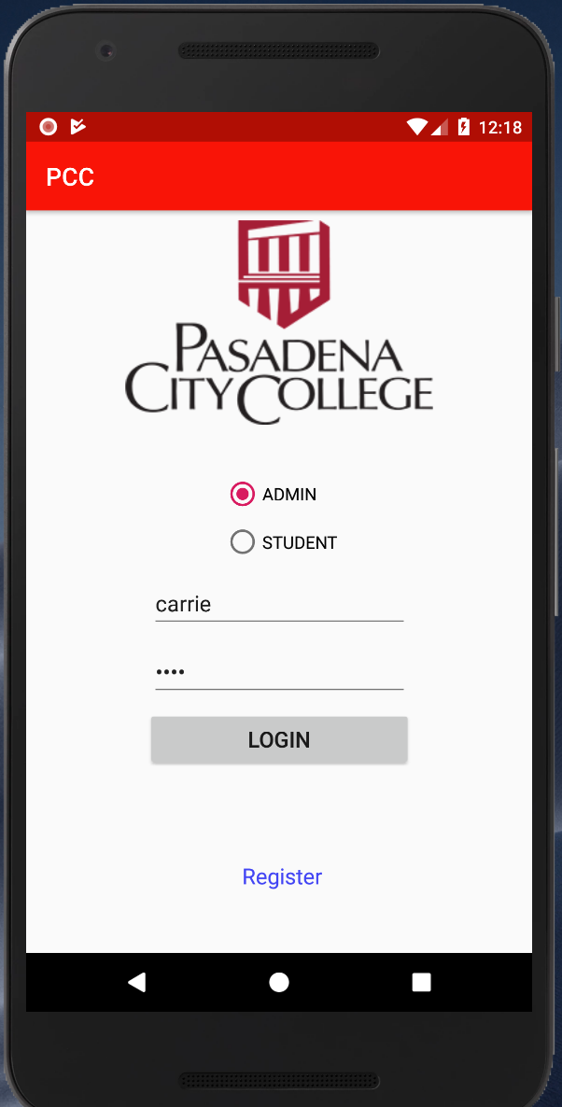
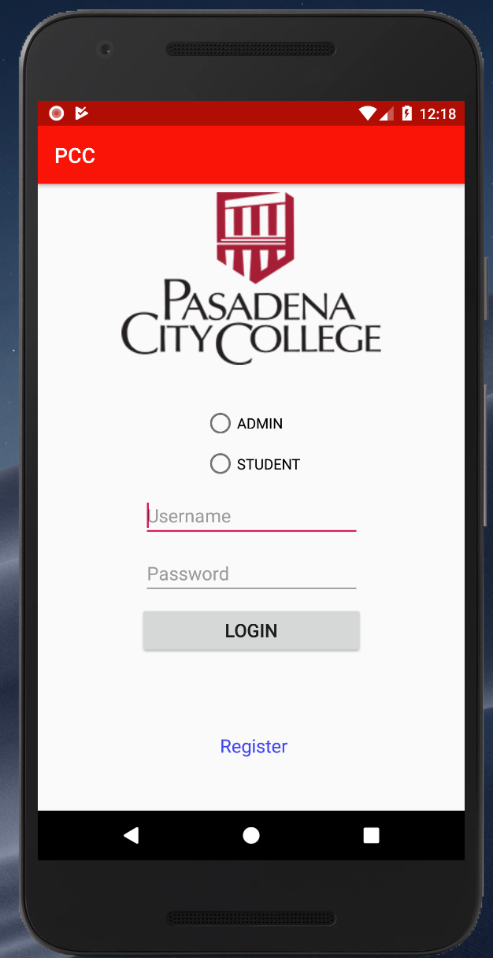
Main Page
Please select your identity and log in with your own USERNAME and PASSWORD.
Please remember Don’t pick the wrong identity when you log in.
If you are new student or new admin, please select your identity and click register.

Slide 3
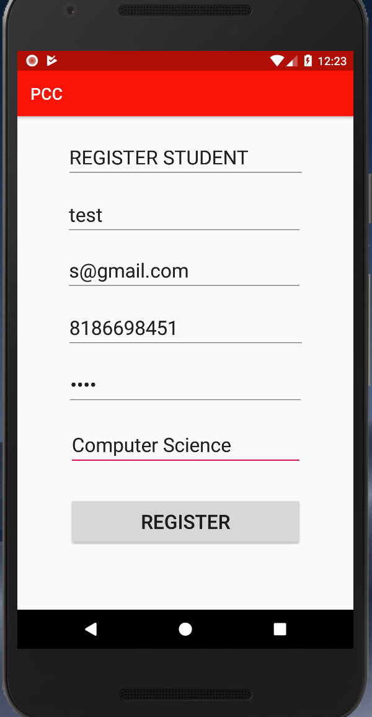
Student Register
This is student register page, you need to enter some information yourself.
1. Name
2. Username
3. Email
4. Phone number(10 digital)
5. Password
6. Major

Slide 4
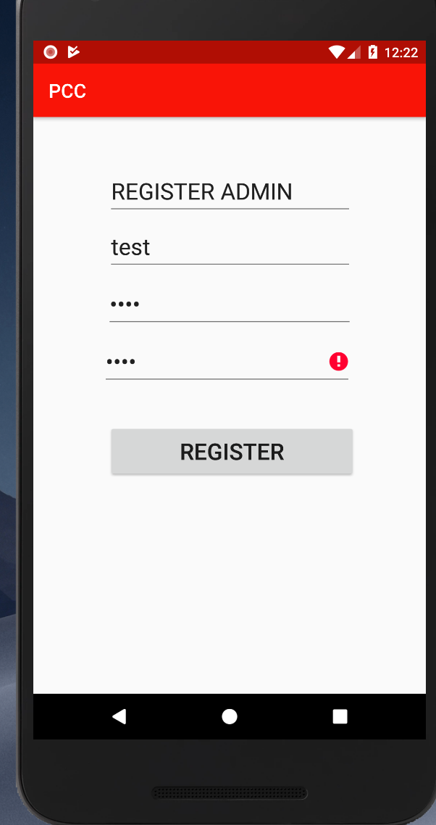
Admin Register
This is the admin register page
1. Name
2. Username
3. Password
4. A Secret Key (This key you need to know before register).

Slide 5
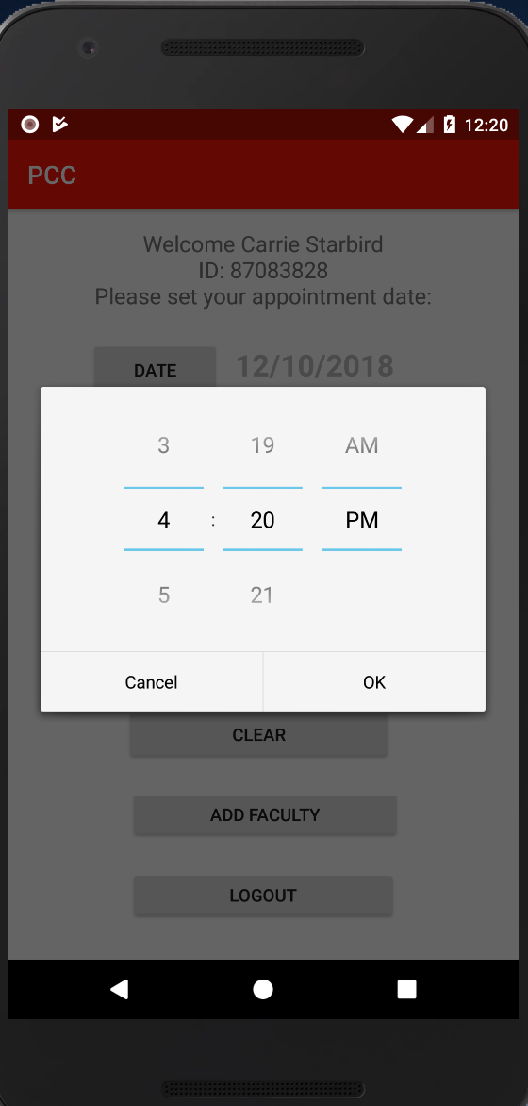
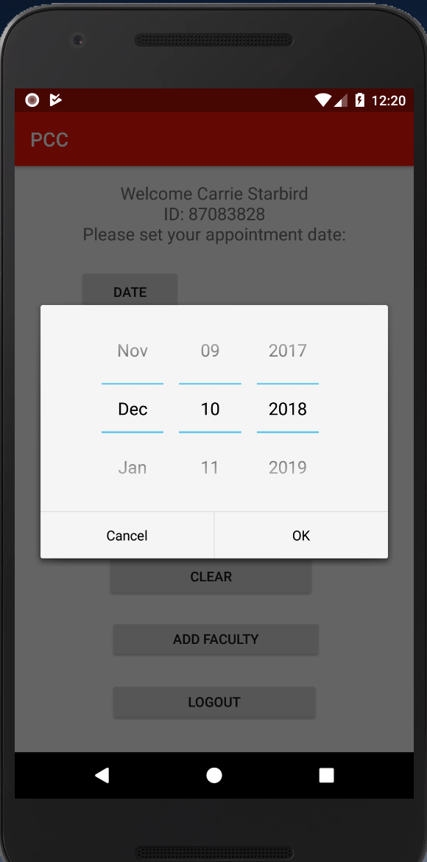
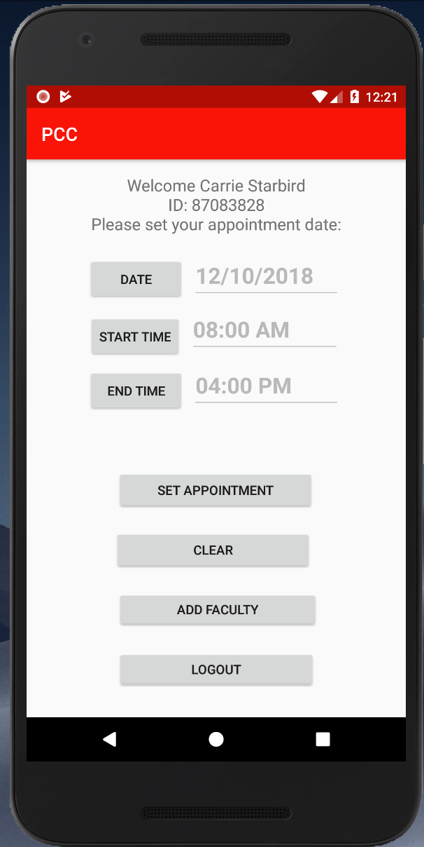
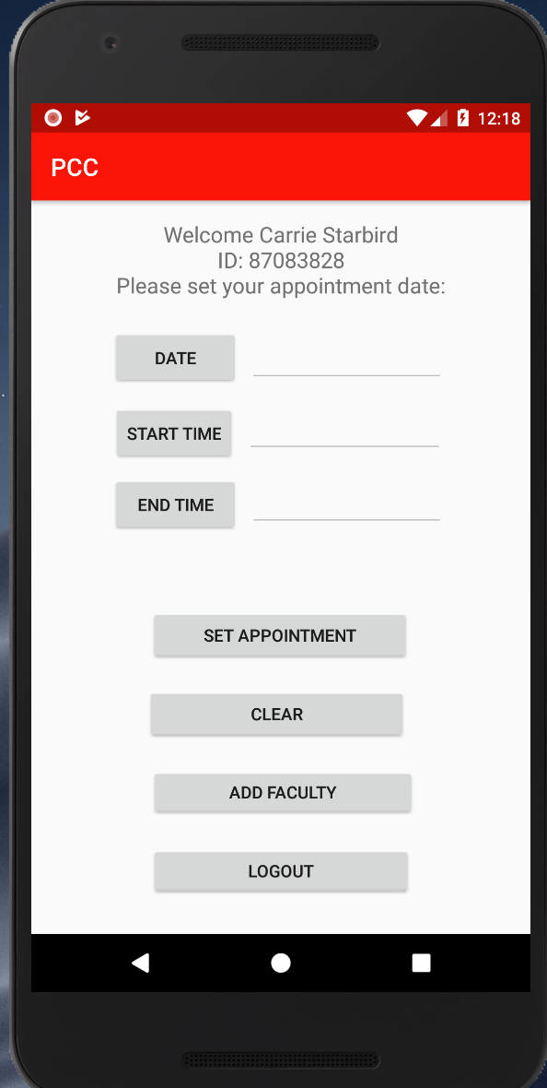
Admin Log in
There are different functions on this page
Date – Select the date of Your available time for appointment
Start Time – beginning time of day
End Time – ending time of day
Set Appointment – Finish setting
Clear – clear the data in this page
Add Faculty – add your information to the faculty
Log out – quit this page.

Slide 6
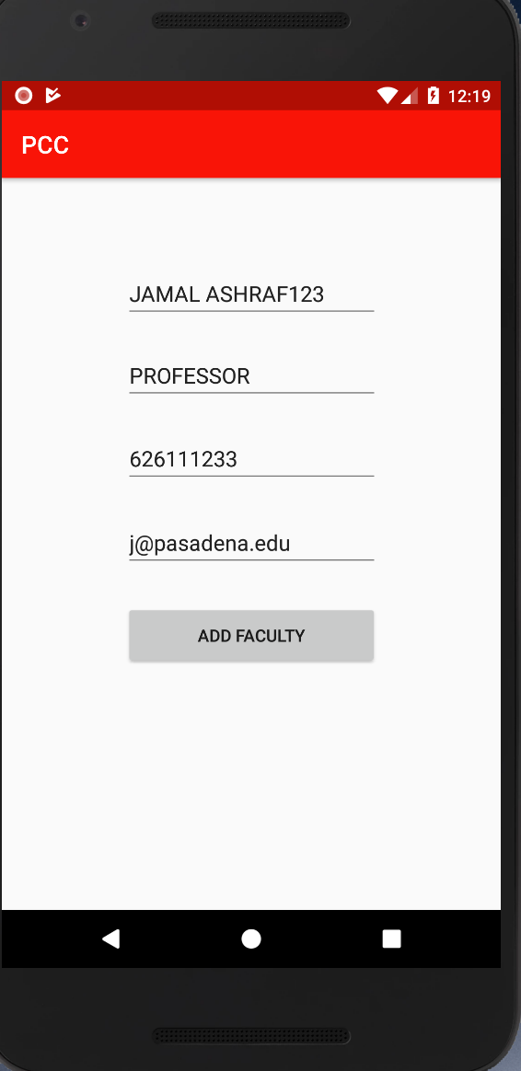
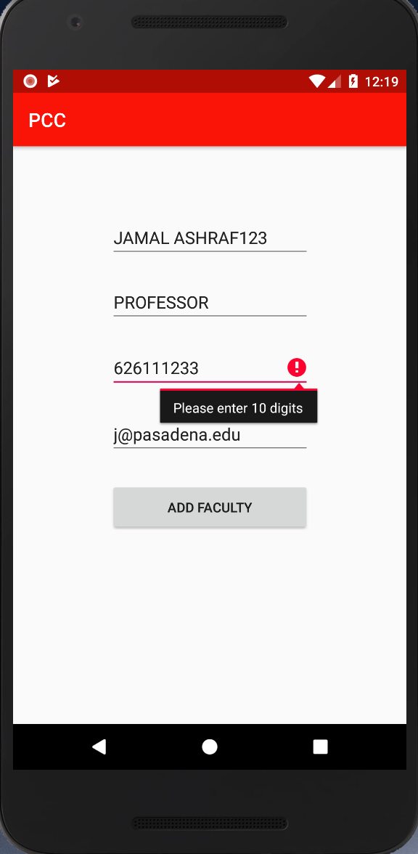
Add Faculty
When you click the Add Faculty, you will see this page.
You need to put down your information, so the app will save it to database.
1. Name
2. Position
3. Phone number(10 digital)
4. Email
When you finish, you can click the button and save it.

Slide 7
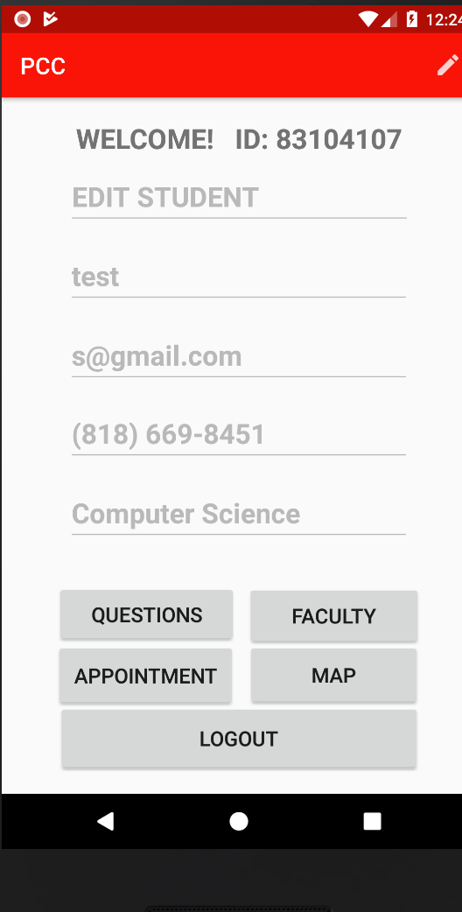
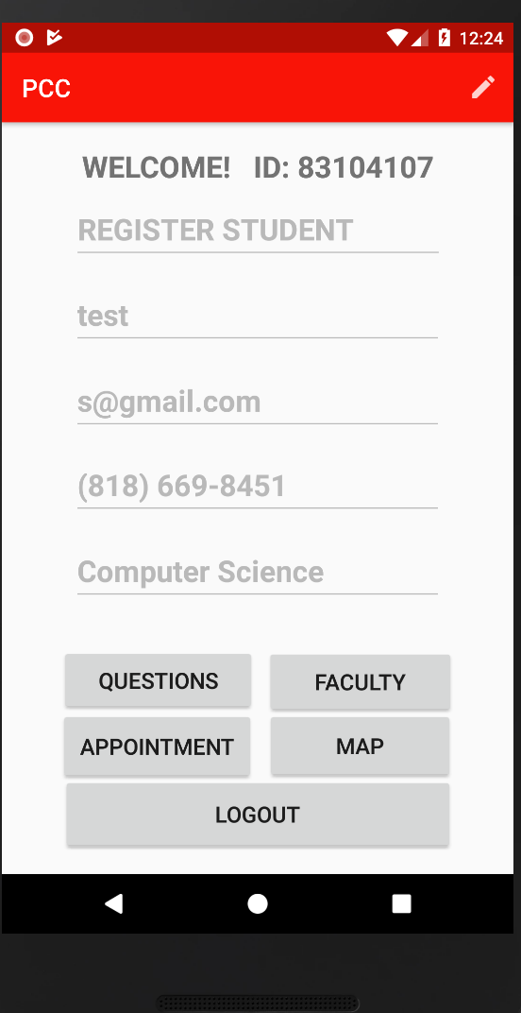
Student page
This is the student page after you log in of student
1. it will show out some information when you register. You can click the pen button at the right up corner to change some information.
2. Question - if you need to ask some question, you can lick it.
3. Faculty – there is all the information of staff
4. Appointment – you can make a appointment to your den
5. Map - you can check the map of school
6. Logout – quit this page.

Slide 8
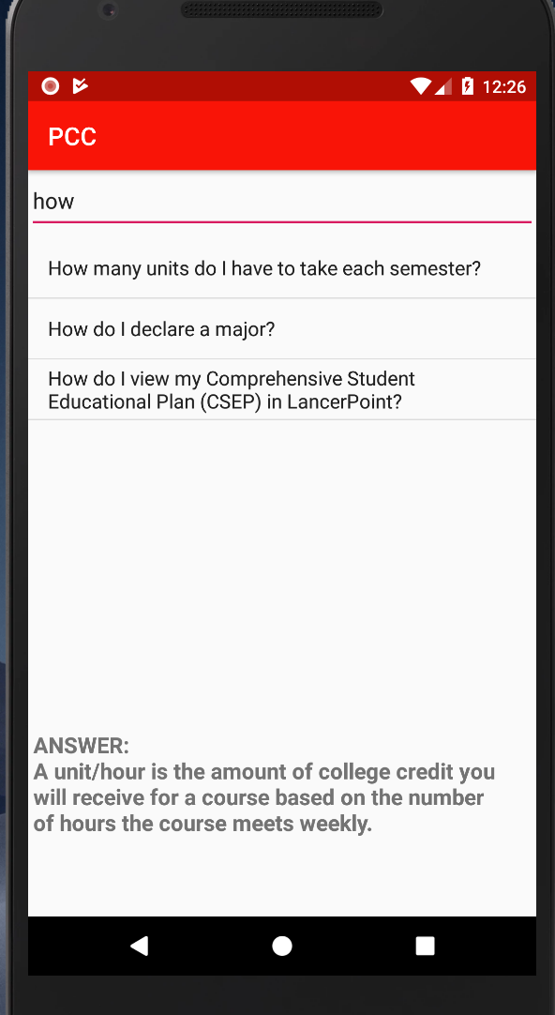
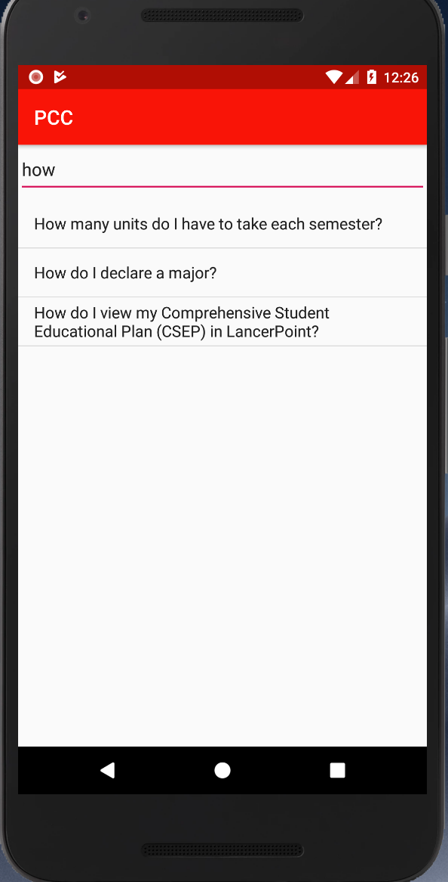
Question
This is a Question page.
You can enter some question you want to ask
If you see the question show below, you can click it and it will show the answer.

Slide 9
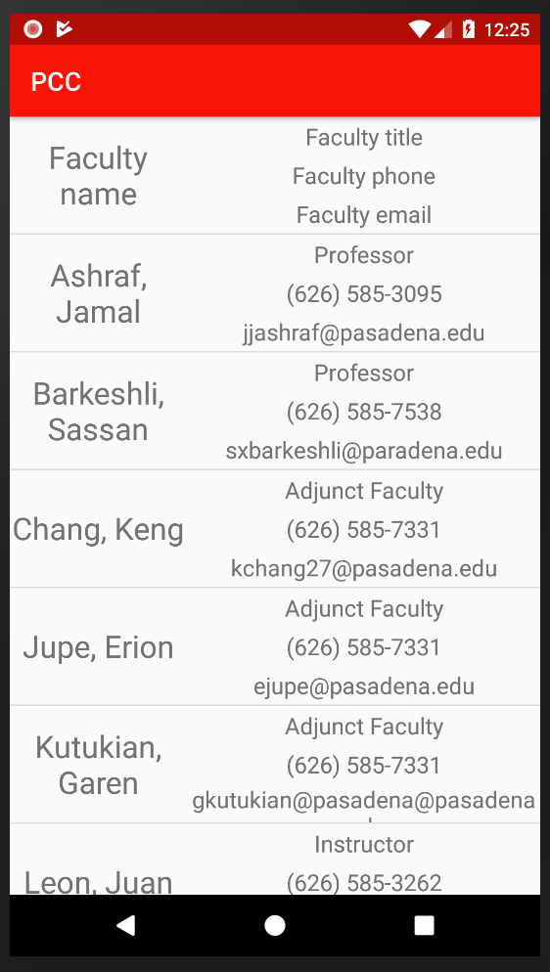
Faculty
This is the Faculty page.
You can see all the information about professors in the school.
1. Name
2. Position
3. Phone number
4. Email

Slide 10
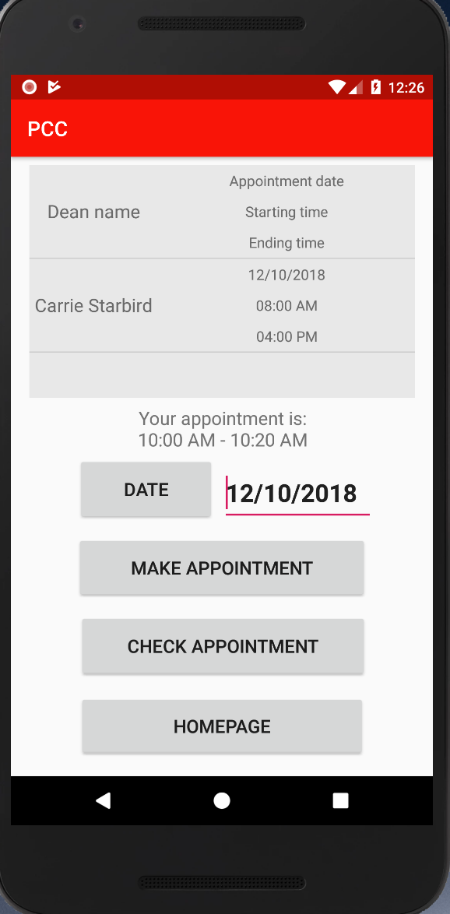
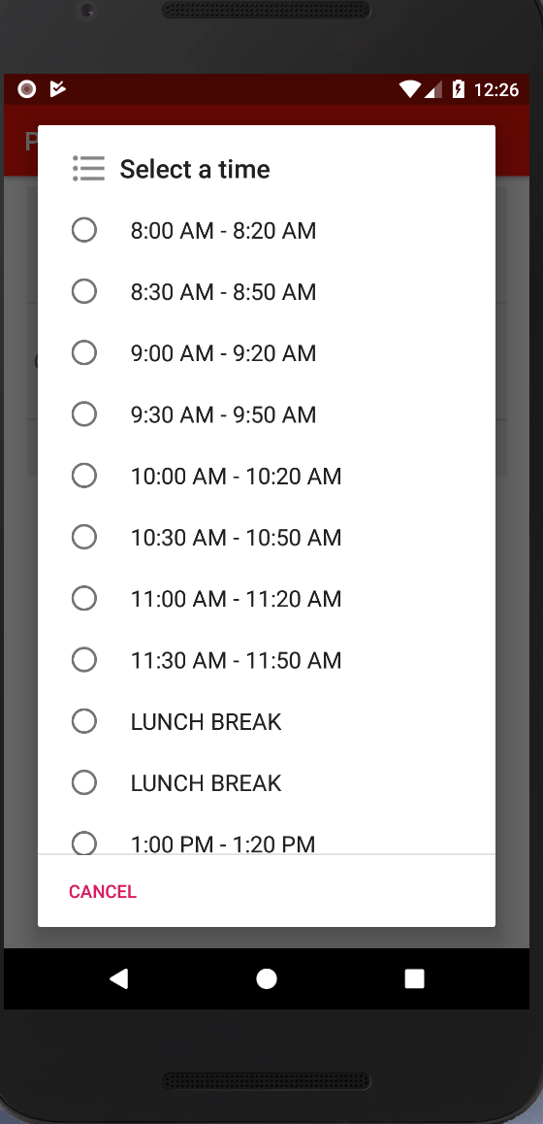
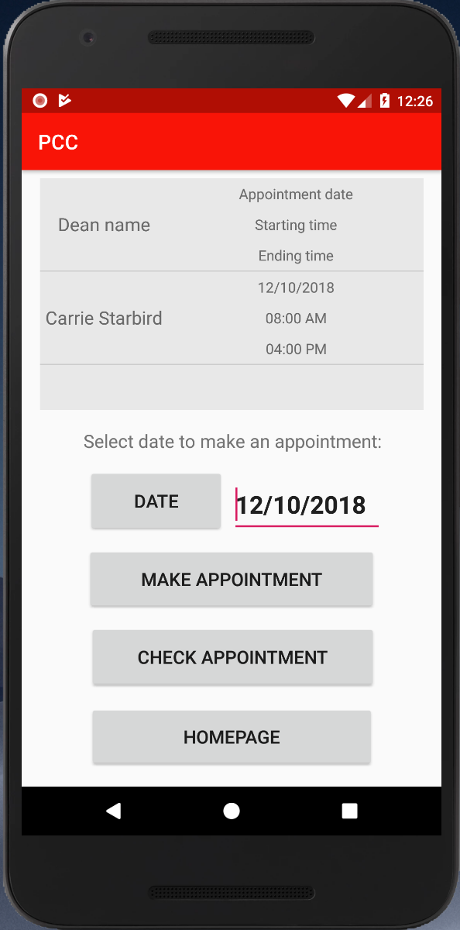
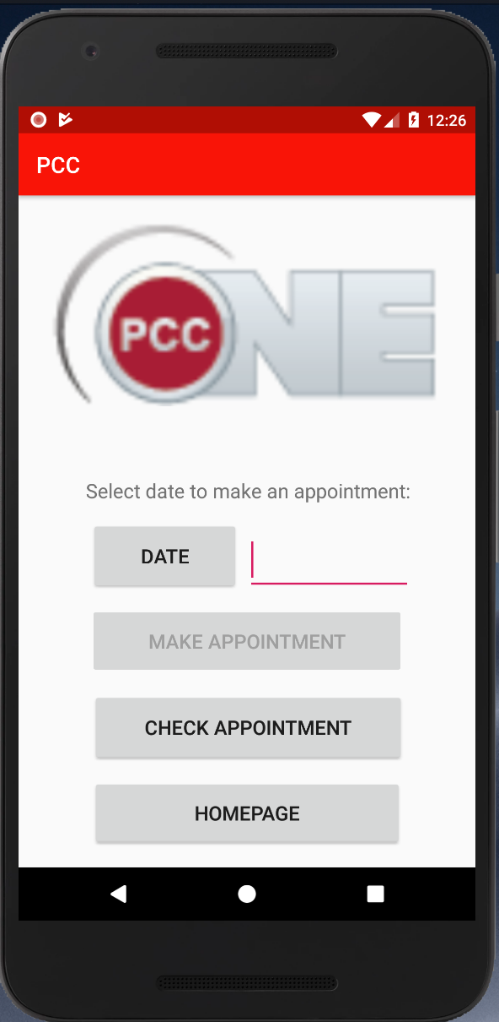
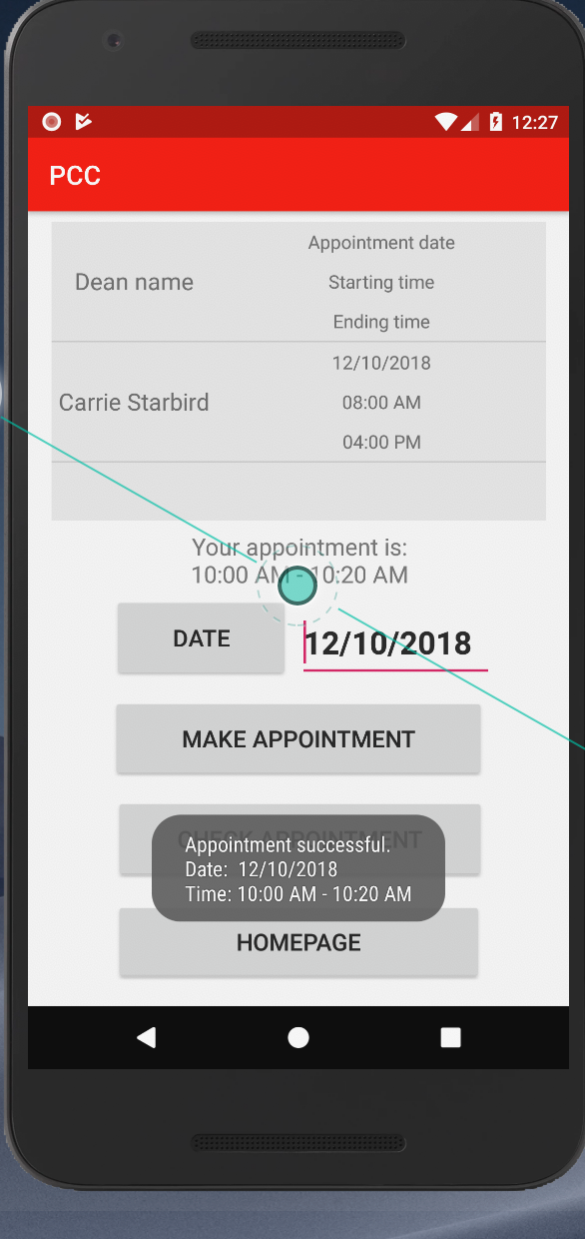
Appointment
This is appointment page
You can select the date and time to make appointment to the den. You can also check your appointment in here.
1. Date – the appointment date you want to pick. When you pick up the date, you can select the available time for it.
2. Check appointment – you can check the appointment at that date.
3. Homepage - go back to the login page.

Slide 11
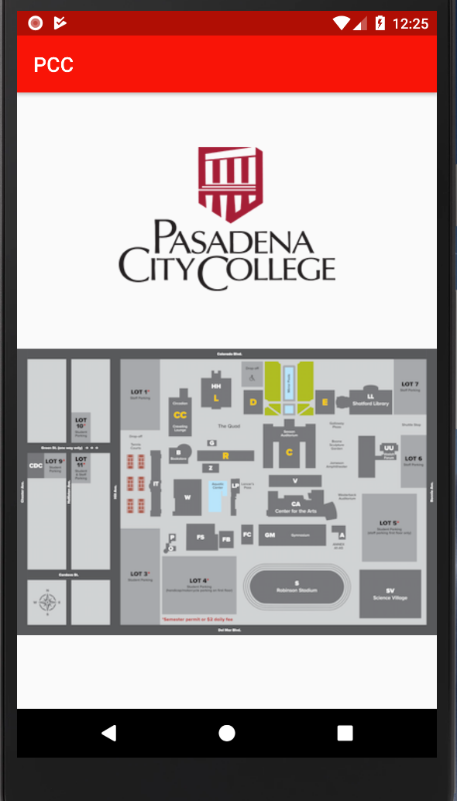
Map Page
This is the page of school map.
You can see the detail number of each building.

Slide 12

Thank you for your use Good bye

